Slide 1





INDIAN STUDENTS AND RESEARCHERS IN KOREA (ISRK)
"STRONGER TOGETHER"
www.isrk.in
joinisrk
teamisrk

Slide 2
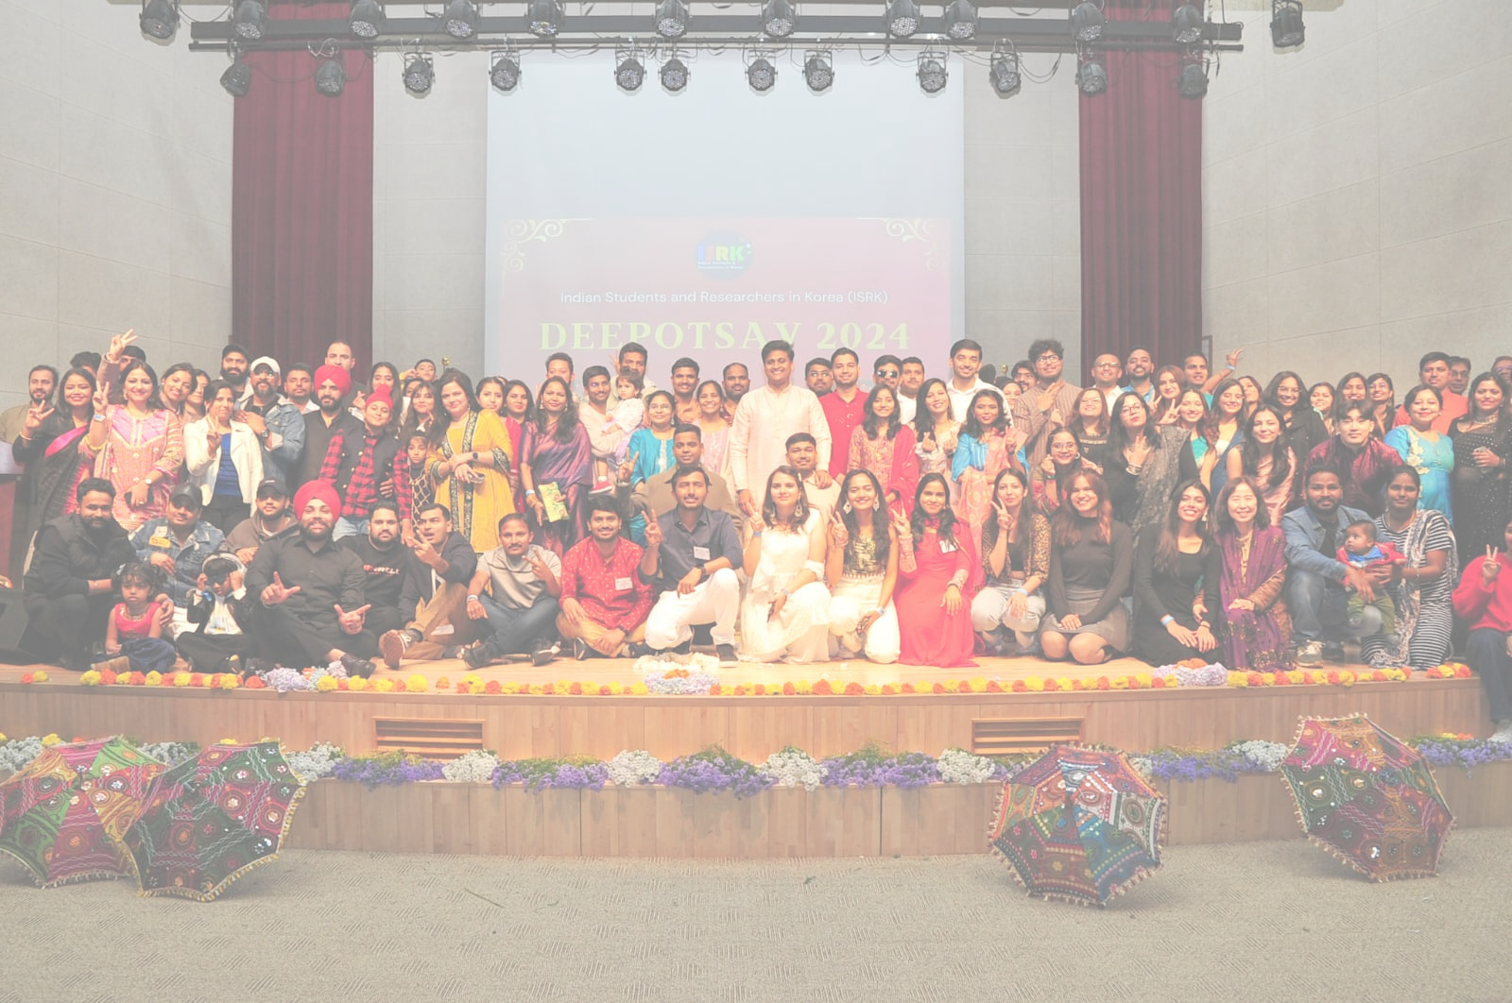

About Us
Founded on 8th May 2019
Indian Students and Researchers in Korea (ISRK) is a non-profit voluntary organization officially registered with the Korean government.
ISRK aims to connect all Indian-origin students and researchers residing in Korea and provide them with support in education, research, social engagement, recreation, employment, and community networking.
May 8, 2019
5,000
Foundation Day
Community

Slide 3
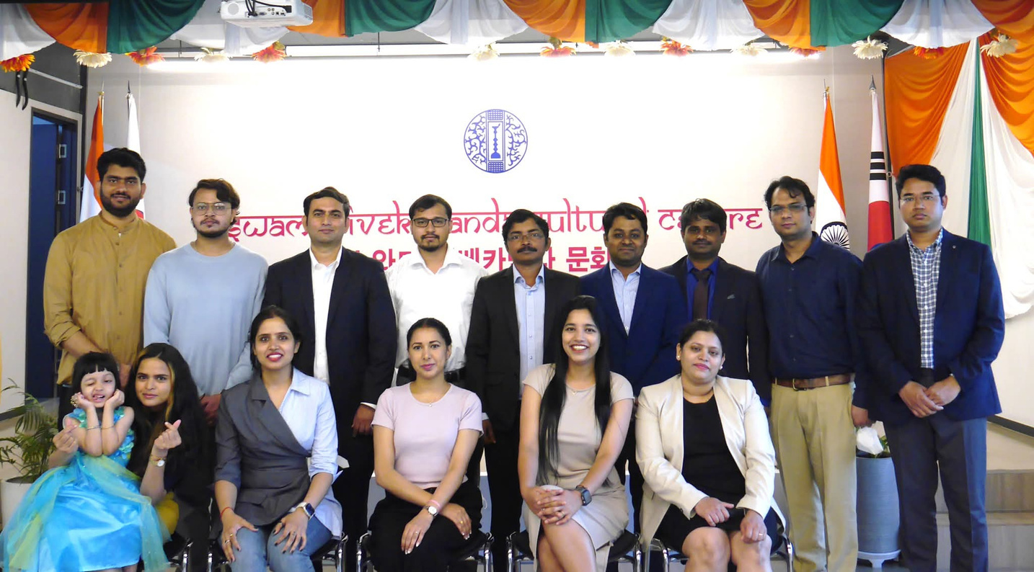
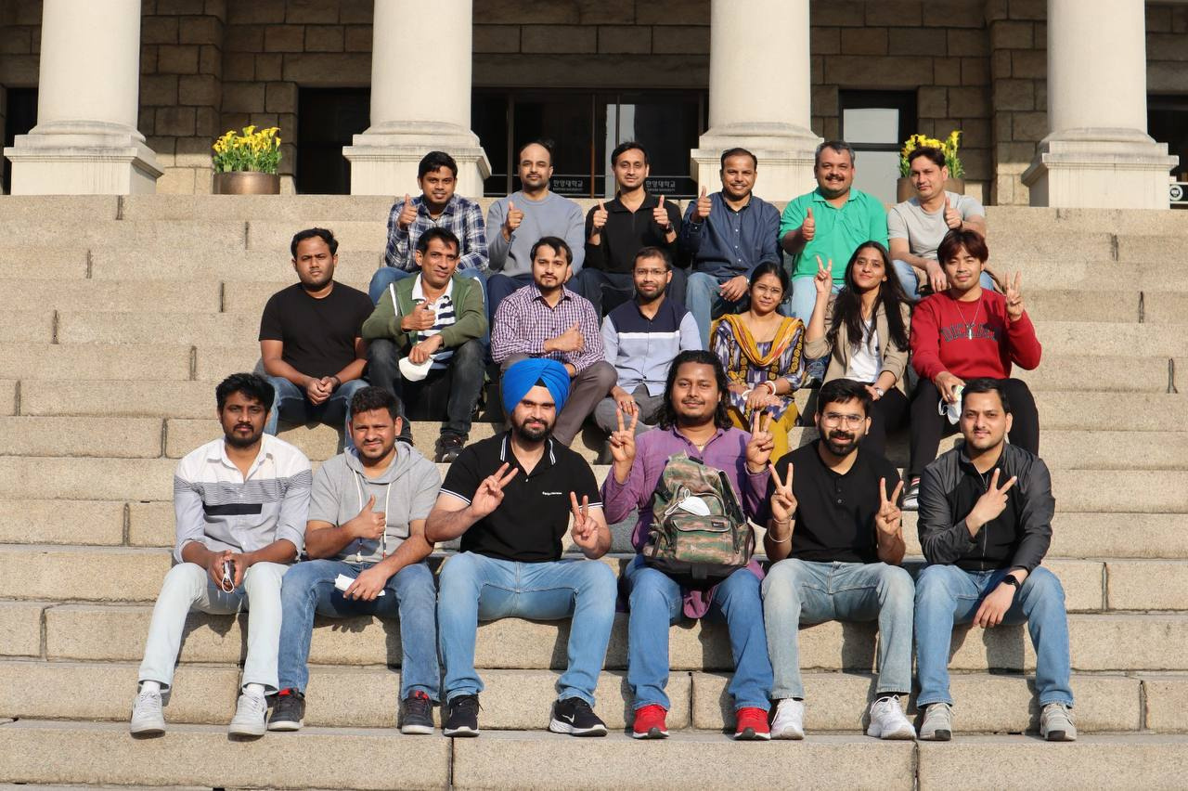
Vision
To promote a better life for Indian students and researchers in Korea.
Mission
To establish the largest community of Indian students and researchers in Korea with strong engagement and interaction opportunities.

Slide 4
STRONGER TOGETHER
Culture & Festivals
Educational Programs
Podcast
Creating a Home Away From Home
ISRK is a vibrant community with a strong organizational structure that works with the motto of “stronger together” to engage the community through various events, activities, workshops, and social gatherings.
Outdoor Recreational Activities
Sports
Events & Technology
Student Affairs
Social Engagement
Travel & Food Vlogs

Slide 5
KEY ACTIVITIES
Providing resources and support for students and researchers through workshops, seminars, and
job-related guidance.
1
Educational Programs and Career Support Initiatives
Assisting students in academic matters and distress or emergencies. Also, other community-based support initiatives.
2
Student Affairs and Community Support
Organizing events and celebrations to mark Indian festivals and cultural occasions, promoting a sense of community and cultural exchange
3
Cultural Events and Festival Celebrations
Organizng sports events and outdoor gatherings to encourage physical wellness and social bonding.
4
Sports and Outdoor Activities

Slide 6
ORGANIZATIONAL STRUCTURE
Founders and Board of Directors
1
Provide strategic vision and long-term goals and policies for the association.
Main Team of ISRK Organization Functioning
Responsible for decision-making related to day-to-day functioning, overall governance, and implementation of the policies.
Executive Board
Leadership team and Executive Secretaries
2
Regional Coordinators and Representatives
3
Coordinate activities locally and represent the association in different cities, provinces, universities, institutes, and companies.
4
Senior Consultant Advisory Board Provide expert advice and mentorship to support the association’s growth.
Senior Consultant
Advisory Board
ISRK Outreach and Promotion Coordinators
5
ISRK Outreach and Promotion Coordinators
Support ISRK outreach promotional activities to boost visibility

Slide 7

EXECUTIVE BOARD
STRUCTURE AND FUNCTIONS
President
Vice President
Vice President
Vice President
Educational Programs and Student Affairs
Cultural Programs
and Events
Sports
Executive
Secretary
Executive
Secretary
Executive
Secretary
Executive
Secretary
Executive
Secretary
Events & Technology
Educational Programs and Student Affairs
Cultural Programs
and Events
Sports
Social engagement and communication
City Coordinators & Representatives

Slide 8
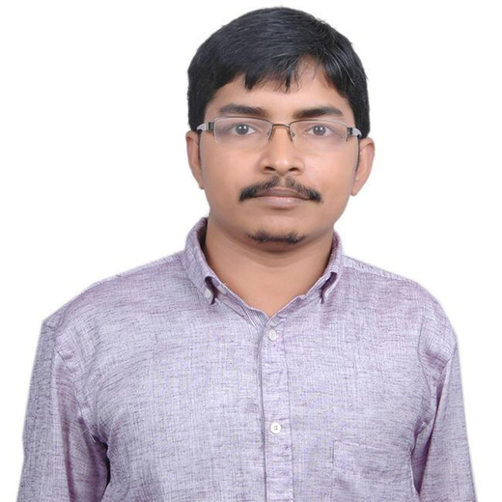
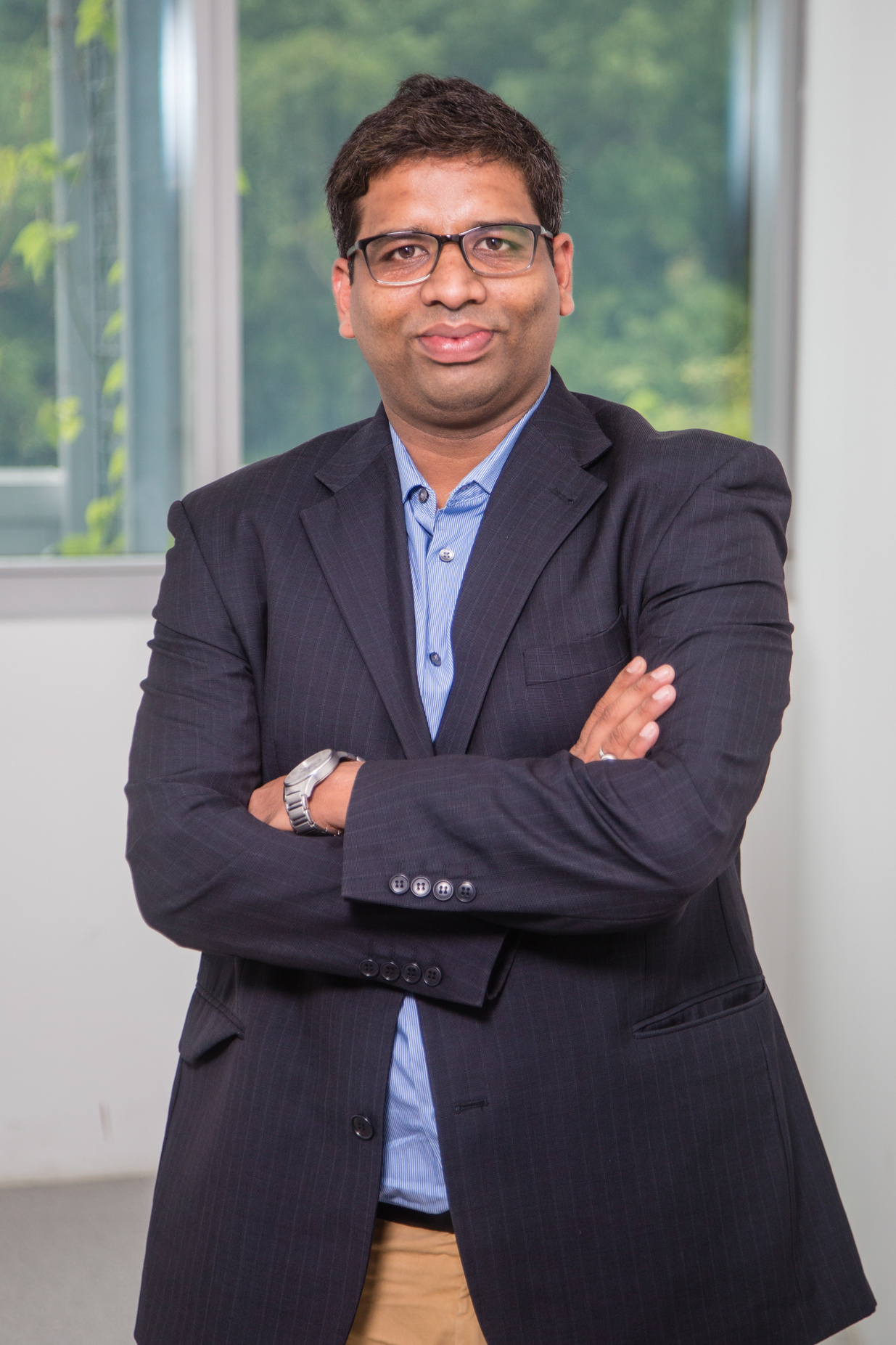
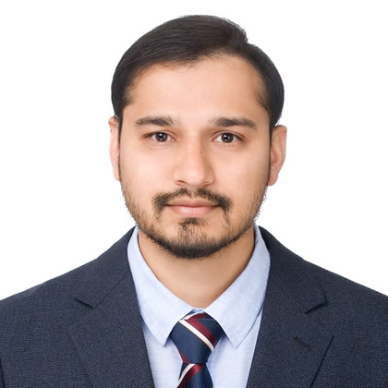
FOUNDERS AND BOARD OF DIRECTORS
Dr. Lailesh Kumar
COO TEXMIN
IIT -ISM Dhanbad, India
Dr. Vibhu Jain
Global Head- Chemistry Synthesis Solution
Merck, Boston, USA
Dr. Mohammed Iqbal Khazi
Research Associate Professor
Hanyang University
Seoul, South Korea

Slide 9
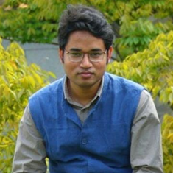
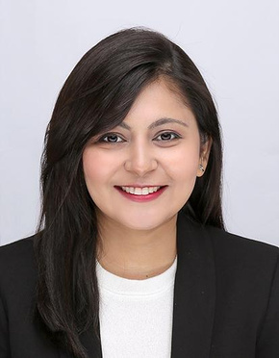
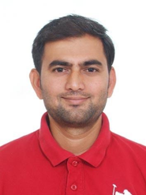
EXECUTIVE BOARD
LEADERSHIP TEAM
Dr. Mohammed Iqbal Khazi
President
Research Associate Professor
Hanyang University
Seoul, South Korea
Dr. Manas Biswal
Vice President - Cultural Programs
and Events
Research Engineer
SRC Co Ltd
Busan, South Korea
Noopur Baghel
Vice President - Educational Programs and Students Affairs
Ph.D. Scholar
Korea University
Seoul, South Korea
Dr. Dilip V. Patil
Vice President - Sports
Senior Researcher
Y S Pharma
Suwon, South Korea

Slide 10
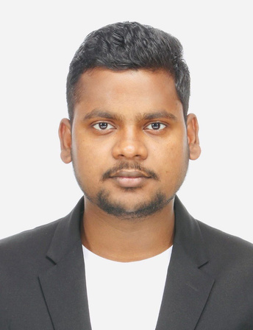
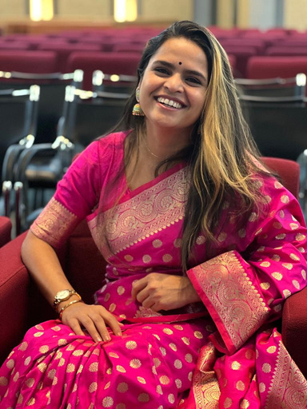
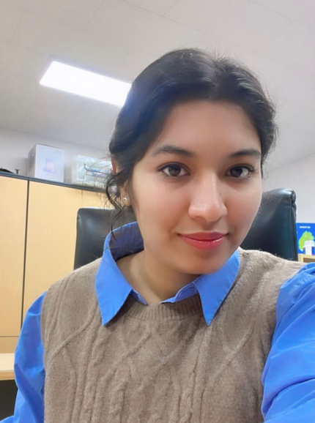
EXECUTIVE BOARD
EDUCATIONAL PROGRAMS AND STUDENT AFFAIRS
Hemant Raj
Executive Secretary
Ph.D. Scholar
Seoul National University
Seoul, South Korea
Pooja Singh
Executive Secretary
Ph.D. Scholar
Gyeongsang National University
Jinju, South Korea
Keerti Yadav
Executive Secretary
Ph.D. Scholar
Kongju National University
Gongju, South Korea

Slide 11
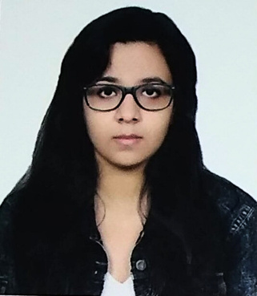
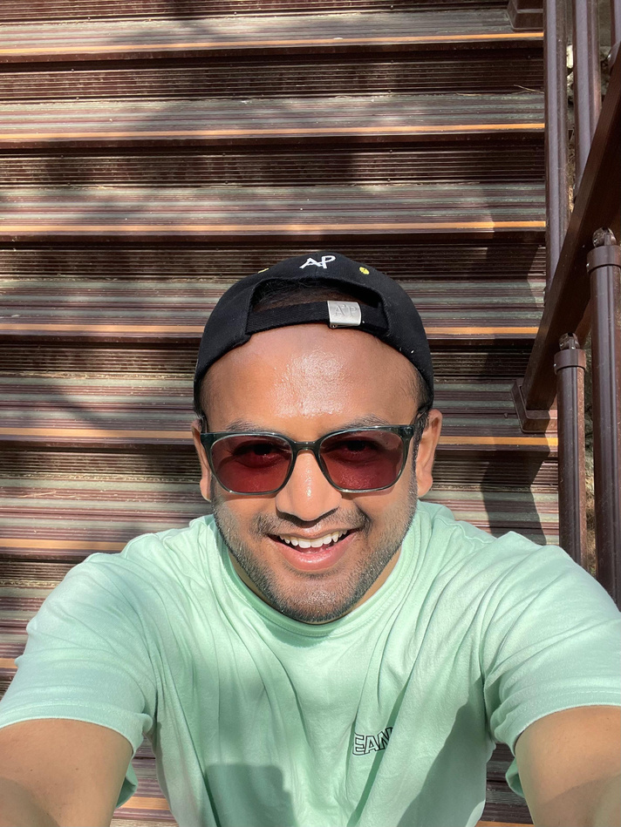
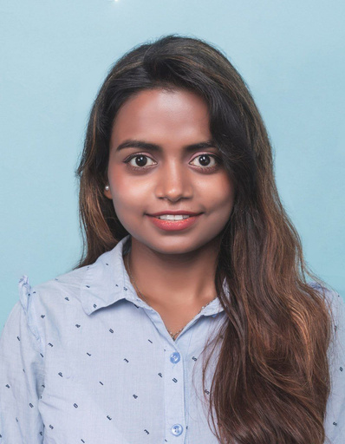
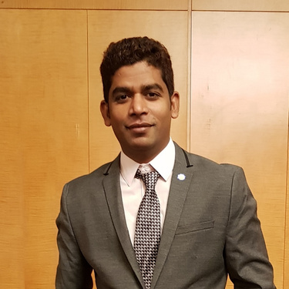
EXECUTIVE BOARD
CULTURAL PROGRAMS AND EVENTS
Shambhavi Sharma
Executive Secretary
Ph.D. Scholar
Korea Railroad Research Institute (KRRI)
Uiwang, South Korea
Tejas
Executive Secretary
Ph.D. Scholar
Korea University
Seoul, South Korea
Dr. Arati Kumari Shah
Executive Secretary
Senior Researcher
Philophos Korea
Seongnam, South Korea
Dr. Chinna Bathula
Executive Secretary
Associate Professor
Dongguk University
Seoul, South Korea

Slide 12
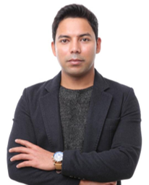
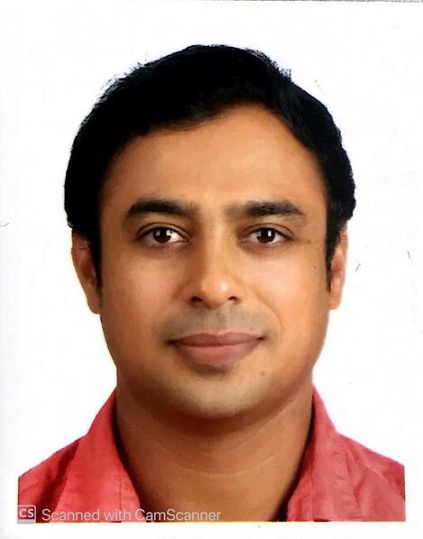
EXECUTIVE BOARD
SPORTS
Kunal Kumar
Executive Secretary
Director
HVS India
Seoul, South Korea
Dr. Pravin P. Upare
Executive Secretary
Principle Research Scientist
Activon Co. Ltd
Cheongju, South Korea

Slide 13
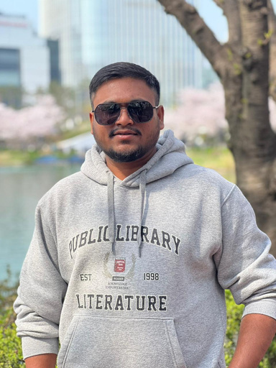
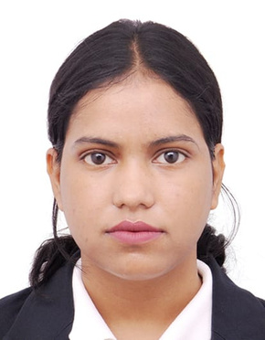
EXECUTIVE BOARD
EVENTS & TECHNOLOGY
Rahul Kumar Patel
Executive Secretary
Ph.D. Scholar
Chung-Ang University
Seoul, South Korea
Shikha
Executive Secretary
MS Student
Seoul National University of science and technology
Seoul, South Korea

Slide 14
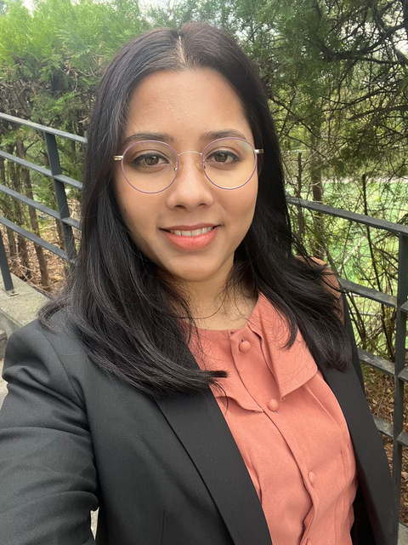
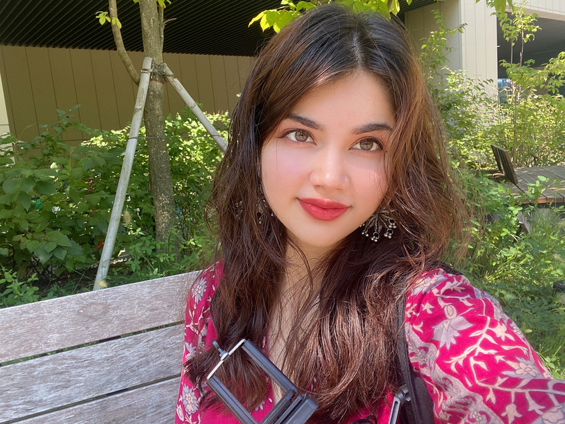
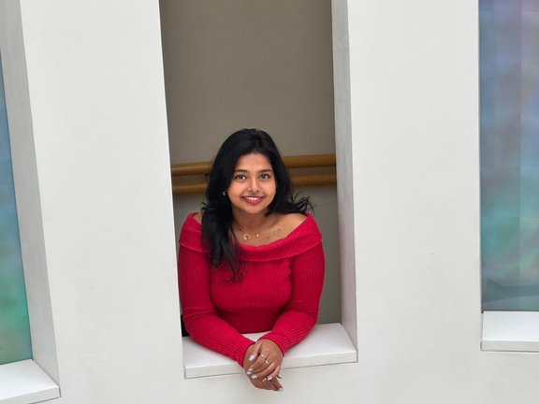
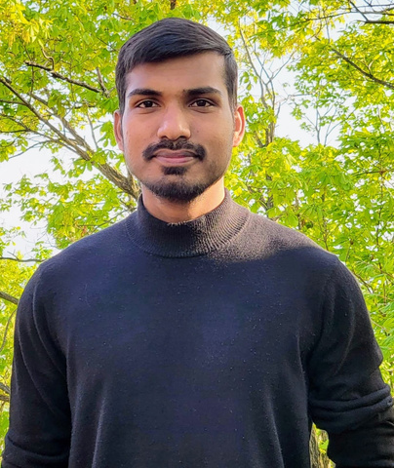
EXECUTIVE BOARD
SOCIAL ENGAGEMENT AND COMMUNICATION
Dr. M Shriya Jaiswal
Executive Secretary
Ph.D. Scholar
Pusan National University
Busan, South Korea
Jannat Shreya
Executive Secretary
BS Student
Seoul National University
Seoul, South Korea
Jaiwanti Sivakumar Executive Secretary
MS Student
Konkuk University
Seoul, South Korea
Adil Sheikh
Executive Secretary
Ph.D. Scholar
Yeungnam University
Daegu, South Korea

Slide 15
CITY COORDINATORS
SEOUL
Rahul Patel, Ph.D. Scholar, ChungAng University
Dr. Chinna Bathula, Associate Professor, Dongguk University
busan
DR. MANAS BISWAL, Research Engineer, SRC Co Ltd
usan National University
Shriya Jaiswal, Ph.D. Scholar, Pusan National University
DAEJON
DR. GAURAV BARTWAL , Posdoc, Cheonam University
Abhishek Negi, Ph.D. Scholar, KRICT
DAEGU
DR. VASUDEVA REDDY, RESEARCH PROFESSOR, YEUNGNAM UNIVERSITY
DR. ALKA SINGH, Research Professor, Yeungnam University
INCHEON
BHASKAR M.C., MANAGER, GENERAL MOTORS KOREA
JEJU
VIShwanathan R, Ph.D. Scholar, Jeju National University
GWANGJU
Dr. Sunil Ghatge, Posdoc, Gwangju Institute of Science and Technology
Vinayak Hegde, Ph.D. Scholar, Chonnam National University
pohang
DR. MINati Das, Postdoc, POSTECH
ulsan
GORakh parsad (Gaurav), Senior Researcher, Interx
Anirban Kundu, Postdoc, UNIST
Sanjay, UNIST
jinju
POOJa Singh, Ph.D. Scholar, Gyeongsang National University
Dr. Amol Jadhav, Postdoc, Gyeongsang National University
naju
DR. MOHaseen Tamboli, Research Professor, KINTECH
YESOU
DR. Kale Amol, Senior Engineer, PineTree PosMagnesium Co., Ltd
SUWON
SHambhavi Sharma, Ph.D. Scholar,Korea Railroad Research Institute (KRRI)
cheongju
DR. PRavin P. Upare, Principle Research Scientist
Activon Co. Ltd
gimhae
ARATRIKa De,Ph.D. Scholar, Inje Universityy
seongnam
DR. ARATI KUMARI SHAH, SENIOR RESEARCHER, PHILOPHOS KOREA
DR. TEJASWINI KADAM, Posdoc, Gachon Univesity
Dr. Mahesh, Posdoc, Gachon Univesity
Sunchon
ALLuri Sai Preetham Reddy, Ph.D. Scholar, Sunchon National University
CHUNCHEON
DR. AYUSHI RANDHAVA, POSTDOC, KANGWON NATIONAL UNIVERSITY

Slide 16
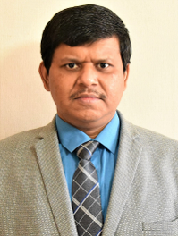
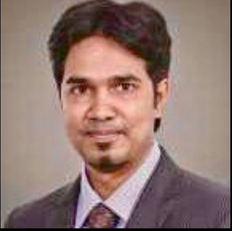
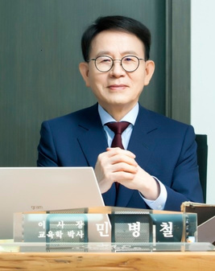

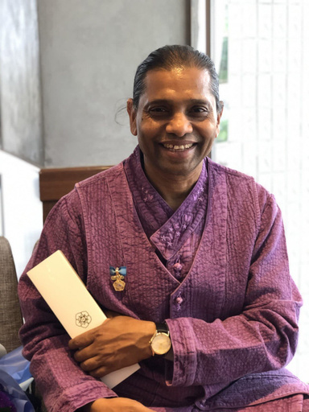
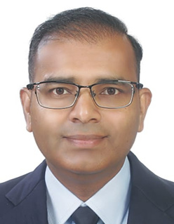
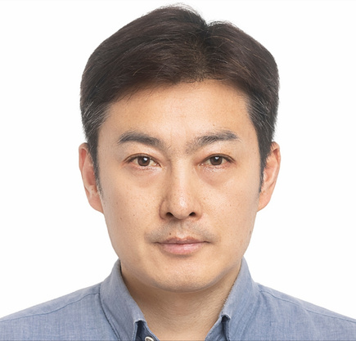
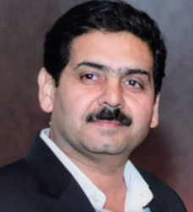
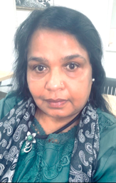
SENIOR CONSULTANT ADVISORY BOARD
Prof. Biswajeet Sarkar
Member, Advisory Board
Professor - Industrial Engineering, Yonsei University
Seoul, South Korea
Mr. Rohit Kunal
Member, Advisory Board
Vice President Global Operation,
Design and SCM Planning, Coupang
Seoul, South Korea
Dr. Min Byoung-chul
Member, Advisory Board
Chairman & Founder, Sunfull Foundation
Seoul, South Korea
Mr. Abhishk Gupta
Member, Advisory Board
Actor and TV Personality
Seoul, South Korea
Prof. Mukul Basu
Member, Advisory Board
Overseas Director of RIST,
President- UCC
Gwangju, South Korea
Mr. Amit Gupta
Member, Advisory Board
Program Manager
Spirit AeroSystems
Busan, South Korea
Mr.Justin You
(Sunghoon You)
Member, Advisory Board
CEO, INDOIN Co., Inc
Centre Head, Korea Centre,
CMR University, Bengaluru
Seoul, South Korea
Mr. Sanjeev K. Ahuja
Member, Advisory Board
Founder & Editor-in-Chief
Asian Community News Network
Gurgaon, India
Mrs. Shanthi Prince
Member, Advisory Board
CEO, Indian Chakraa Restaurant & Expat Mart
Seoul, South Korea

Slide 17

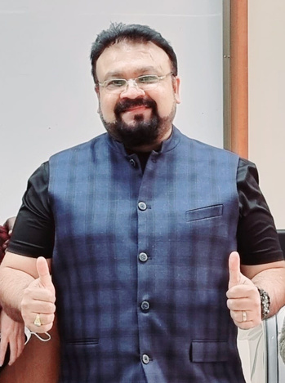
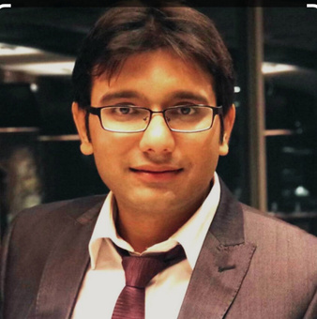
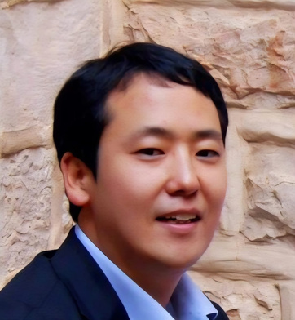
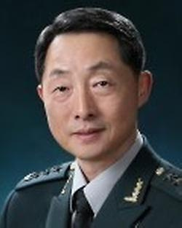
SENIOR CONSULTANT ADVISORY BOARD
Dr.Jaydip Chandrkant Mehta
Member, Advisory Board
Professor, International Graduate School MGTE, MIB Department
Namseoul University
Cheonan, South Korea
Dr. Pankaj Garg
Member, Advisory Board
Vice-CTO and R&D head
ELBIO Inc. Korea
Seoul, South Korea
Prof. Seok-gu Lee
Member, Advisory Board
Distinguished Professor, GLC, Yonsei University
Seoul, South Korea
& Former Ambassador of the Republic of Korea to UAE
Dr. Geon Do Park
Member, Advisory Board
Director
Dasan Call Foundation
Seoul, South Korea

Slide 18

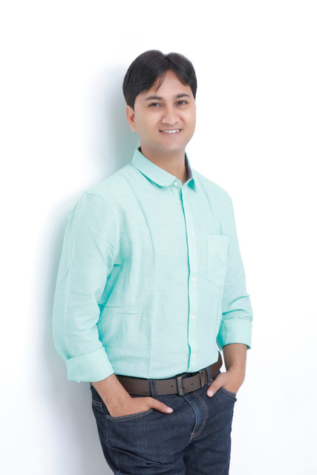
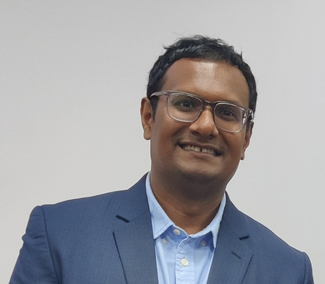
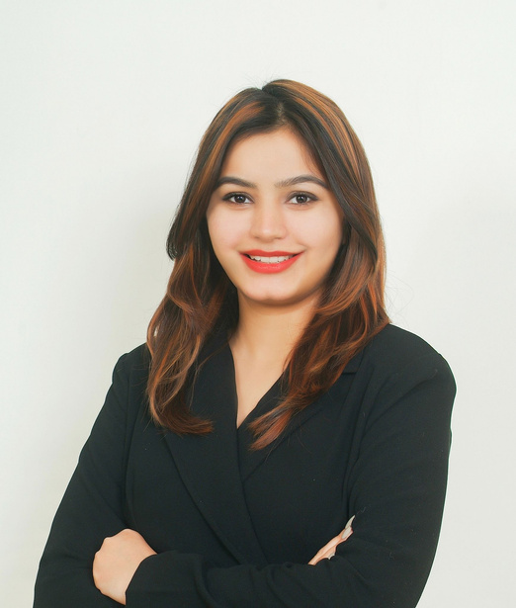
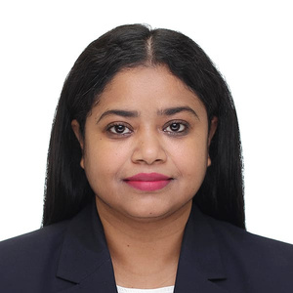
ISRK OUTREACH AND PROMOTION CONSULTANT
Dr. Srijan Kumar
Associate professor
Busan University of Foreign Studies
Busan, South Korea
Ravi Pandit
Entrepreneur
Dr. Soyoun Lim
CEO,
K-CareerNet Korea
Seoul, South Korea
Founder & CEO
Konnect Korea
Daejon, South Korea
Shivani Ahuja
Creative Writer & Project Manager
BCM Educational Group
Seoul, South Korea
Gitika Talukdar
International Sports Jounalist & Photographer
Seoul, South Korea

Slide 19
EDUCATIONAL PROGRAMS AND STUDENT AFFAIRS ACTIVITIES
SCHOLARSHIP WEBINAR
INVITED TALK
BS, MS, Ph.D. and Post-Doc , Schools
opportunities in Korea
Scientists from Academics & Industries
CONFERENCE / WORKISHOP
NETWORKING EVENT
India / Korea Universities
Collaboration & MoU
Job / Research Opportunity Information
STUDENT AFFAIRS ACTIVITIES
ACADEMIC GUIDANCE CELL
STUDENTS MEETUP

Slide 20

CULTURAL PROGRAMS
AND EVENTS
1
HOLI
In collaboration with IIK
2
FOUNDATION DAY
Networking Event
3
INDO-UTSAV
Independence Day
CULTURAL EVENT
4
YOGA DAY
5
GARBA MAHOTSAV
6
DEEPOTSAV
Diwali Event
7
BOLLYWOOD NIGHT

Slide 21





SPORTS AND OUTDOOR ACTIVITIES
HOLI
01. Cricket
02. Hiking / Trekking
Seoul
04. Tours /Trips
with Social Engagement Team
& Student Affairs Team
04. Cycling

Slide 22






SOCIAL ENGAGEMENT
A. Travel Vlogs
Exploring beautiful destination
B. Food Vlogs
Introducing Korean food
A
B
C. Instagram Content
Travel & Food Vlog
C

Slide 23








PODCAST - LIFE IN KOREA, WORK & EXPERIENCES
Podcast in English & different regional languages
01
Guest - academic & Industries (Korea and across globe)
03
MULTILINGUAL
PODCAST
Walk-The-Talk Show
02

Slide 24
2024-2025
ONLINE
EVENTS
Educational Webinar
ISRK-ACS Webinar
KLiK JobKorea-ISRK Online Job Fair
ISRK Student Affairs Meeting
ISRK
ACTIVTIES
Foundation Day & Networking Event
Indo-Utsav (Independence Day)
Cricket Tournament
Garba Mahotsav
Deepotsav
Orientation and Networking Event (Embassy of India)
Year-End Party
Eid Milan
Holi Celebration (with IIK)
SPIC MACAY -Lycée français de Séoul Event
In 2024–2025 (till date), ISRK has organized many offline events in different parts of Korea, including Seoul, Gwangju, Busan, Daegu, and Seongnam.
OFFLINE
EVENTS
ISRK has also conducted online events focused on education and student affairs.
Seoul Friendship Festival
Sinchon International Youth Festival
NIIED Year-End Party
ISRK Team-Ambassador, Embassy of India Meeting
ISRK – Center for Quantum Nanoscience, Institute of Basic Sciences
ISRK-Super 30 Anand Kumar Meeting
NIIED International Associations Meeting
ISRK has actively participated in meetings and events organized by the Embassy of India in Seoul.
MEETING / PARTICIPATION

Slide 25
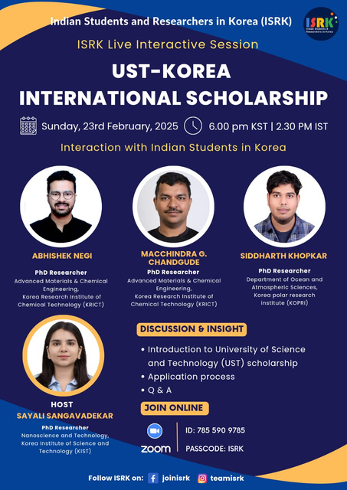
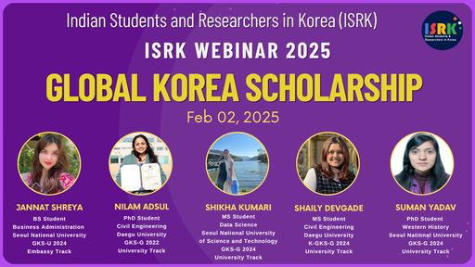
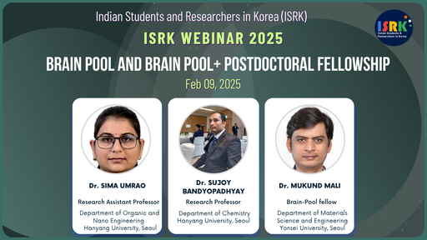
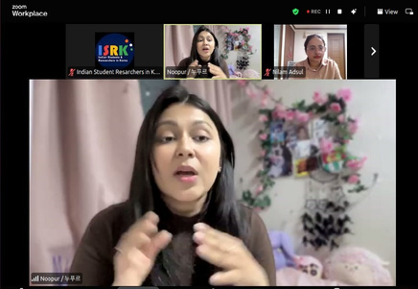


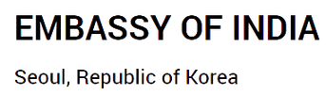


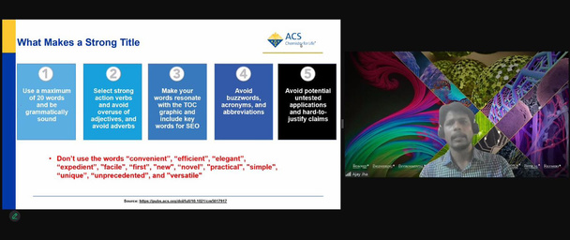
Online Webinar on Scholarship Programs for Higher Studies and Fellowships for Postdoctoral Research
EDUCATIONAL/ RESEARCH PROGRAMS & STUDENT AFFAIRS
ISRK and ACS : Tips for Scholarly Publishing
KEY COLLOBORATION

Slide 26
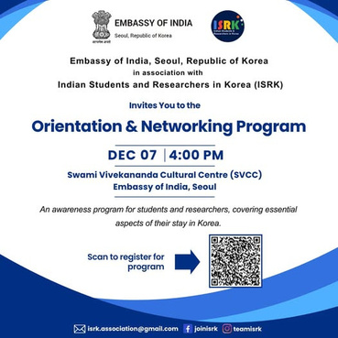
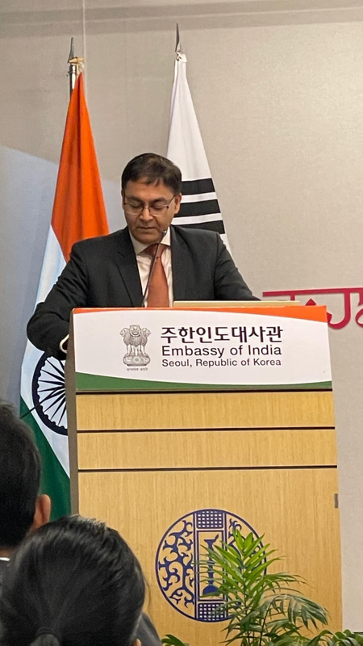
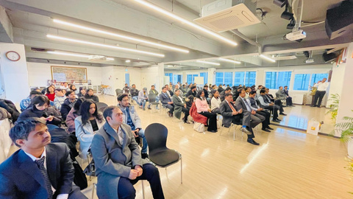
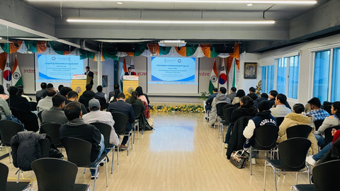




ISRK – Embassy of India: Orientation and Networking Event
EDUCATIONAL/ RESEARCH PROGRAMS & STUDENT AFFAIRS
KLiK JobKorea-ISRK Online Job Fair
KEY COLLOBORATION

Slide 27









CULTURAL PROGRAMS & EVENTS
Foundation Day & Networking Event
Seoul
Collaboration- JobBridge
KEY COLLOBORATION
Indo-Utsav (Independence Day)
Busan
Collaboration- India Center , Busan
Garba Mahotsav
Daegu

Slide 28






Deepotsav ‘Diwali’
Seoul
CULTURAL PROGRAMS & EVENTS
Year-End Party
Daegu
Bollywood Night
Seoul

Slide 29






Eid Milan
Gunpo (Suwon)
CULTURAL PROGRAMS & EVENTS
Holi - Holi Hai (with IIK)
Chuncheon
SPIC MACAY -Lycée français de Séoul Classical Odissi lec dem
Seoul

Slide 30



SPORTS
CRICKET
CHAMPIONSHIP
GIST, Gwangju

Slide 31








MEETINGS /EVENT PARTICIPATION
ISRK Team meeting with Ambassador, Embassy of India
ISRK – Center for Quantum Nanoscience,
Institute of Basic Sciences
ISRK - Super 30 Fame
Mr. Anand Kumar Meeting at Embassy of India
NIIED International Associations Meeting
Adventure Tours
Adventure Tours
Adventure Tours
Adventure Tours

Slide 32






MEETINGS /EVENT PARTICIPATION
NIIED Year-End Party
Seoul Friendship Festival
Sinchon International
outh Festival
Adventure Tours
Adventure Tours
Adventure Tours

Slide 33


SIGNIFICANT ACHIEVEMENTS
COMMUNITY SUPPORT DURING COVID-19
ISRK arranged five chartered flights with Asiana Airlines from June 2020 to August 2022.
Approximately 1,000 Indians including students, professionals, and families to travel to Korea for academic programs, new jobs, and family reunions.
Online sessions were hosted to provide travel information and COVID-19 guidelines.
ISRK also facilitated full refunds for 162 passengers affected by a cancelled Air India flight, through persistent engagement with senior officials at Air India headquarters in New Delhi.
In addition to travel support, ISRK, in collaboration with Merck KGaA Korea, distributed safety kits (masks and sanitizers) and office stationery to 1,000 students and researchers across various universities and institutes in Korea.
"Vasudhaiva KutumbAKAM"

Slide 34









SIGNIFICANT ACHIEVEMENTS
ThE LAUNCH OF
Spic Macay KOREA CHAPTER
Society for the Promotion of Indian Classical Music And Culture Amongst Youth (SPIC MACAY) is a voluntary youth movement that promotes India's rich cultural heritage.
SPIC MACAY Korea was launched in association with ISRK and the Swami Vivekananda Cultural Centre, Embassy of India, Seoul, on 07 February 2021.
MYSTICMUSICSERIES with Pt. Vishwa Mohan Bhatt & Ustad Wasifuddin Dagar organized by SPIC MACAY Korea.

Slide 35







SIGNIFICANT ACHIEVEMENTS
ThE LAUNCH OF
DISTinguished Indian HeROS OF SCIENCE & TECHNOLOGY
On the occasion of the 75th anniversary of India's independence, ISRK launched an initiative to highlight the contributions of Indian scientists over the decades.
The initiative featured the work of Indian Nobel Laureates and recipients of the Bharat Ratna, Padma Vibhushan, Padma Bhushan, and Padma Shri awards through infographics and select interactive sessions.

Slide 36











IMPORTANT ACTIVITIES
ISRK'S
ADVENTURE EXPLORATION: A HIKING EXPEDITION
ACROSS 12 CITIES IN KOREA
Organized hiking expedition across 16 different cities in Korea in 2023.
Seoul, Suwon, Incheon, Daejeon, Daegu, Busan, Ulsan, Gwangju, Jinju, Geoje, Cheonan, Jeju

Slide 37








IMPORTANT ACTIVITIES
TRIP TO
TRIP TO
TEMPLE STAY - GWANGJU
BOSEONG TEA GARDEN
GOHEUNG YUJA FESTIVAL AND SUNCHEON GARDEN

Slide 38










OUR SUPPORTERS
& PARTNERS
GOVERNMENT & NON-GOVERNMENT ORGANIZATION SUPPORT
EMBASSY OF THE REPUBLIC OF KOREA TO THE REPUBLIC OF INDIA

Slide 39









OUR SUPPORTERS
& PARTNERS
INDIAN COMMUNITIES IN KOREA
Indians in Korea
Korea Kannada Koota
Marathi Mandal, Korea
Korea Tamil Sangham
Telugu Association of
South Korea
Bengali Association of Korea
Friends of Bihar & Jharkhand in
Republic of Korea
Assam Association of
South Korea
Keralites in Korea

Slide 40
































OUR SUPPORTERS
& PARTNERS
SPONSORS & COLLOBORATORS

Slide 41



THANK YOU
VISIT US
www.isrk.in
joinisrk
teamisrk
isrk.association@gmail.com

Slide 42


